Slide 1
MAXIMIZING BIOSPECIMEN COLLECTION FOR CHILDHOOD DISORDERS
Collaborators:
Lisa Croen (KPNC), Francis Lynch (KPNW), Ashli Owen-Smith (KPGA)

Slide 2
Main Objective
Identify the best ways to maximize biospecimen collection from children with mental health conditions.
Autism Spectrum Disorders
Bipolar Disorder

Slide 3
Revised Specific Aims
Specific Aim 1: Examine demographic and clinical characteristics of children and their families predicting successful recruitment of families to participate in biospecimen collection
  Use data collected as part of MHRN1 Autism Project
Specific Aim 2: Explore knowledge, attitudes and beliefs about biobanking and perceived facilitators and barriers to biobank participation among parents of children with mental health conditions from diverse backgrounds using ethnographic/qualitative methods (interviews, focus groups).
Specific Aim 3:
  a) Develop tailored methods for recruiting and consenting children/adolescents with mental health conditions and their families into a biospecimen bank for future research
  b) Develop a strategy for pilot testing those methods across different pediatric mental health conditions. Focus on low cost methods appropriate for large and diverse populations

Slide 4
Progress this reporting period (July 2016-June 2017)
Specific Aim 1
  Monthly phone calls with project team
  Conducted analyses
  Drafting manuscript
Specific Aim 2
  Piloted interviews
  Conducted case ascertainment of ASD families at all sites; identified bipolar disorder patients at KPNC site
  Obtained authorization from PCPs to recruit eligible participants
  Set up participant tracking system
  Developed protocol for sharing interview data
  Recruited participants
  Conducted participant interviews (45 ASD, 12 Bipolar)
  Coded interviews for analysis
  Established inter-coder reliability through iterative process
  Prepared data for thematic analysis

Slide 5
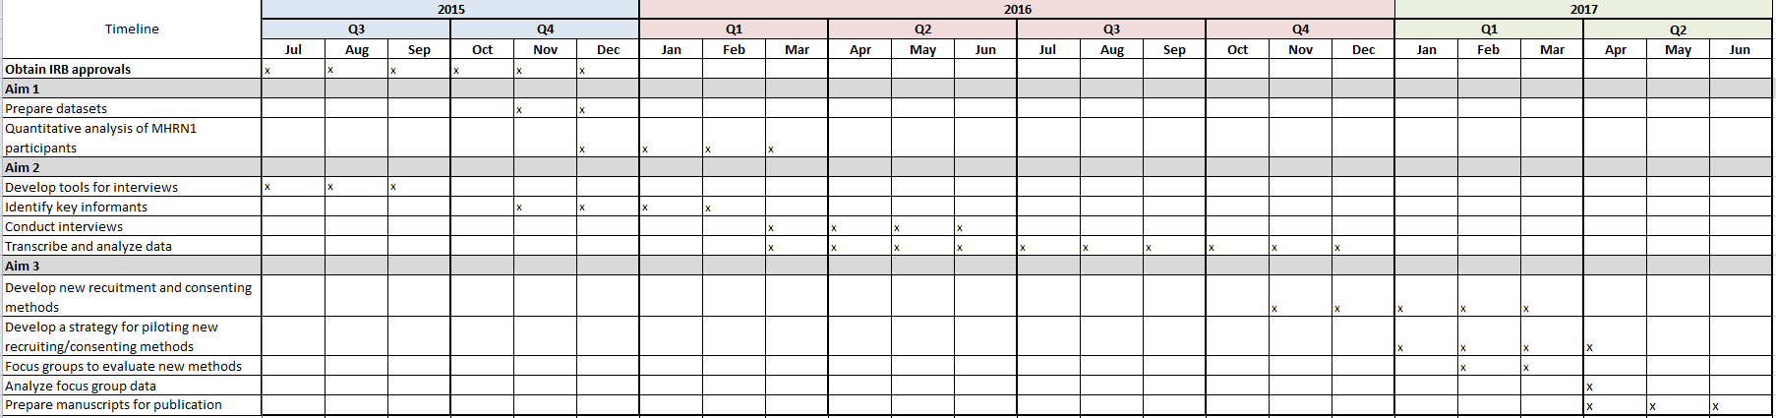
Project Timeline

Slide 6
Planned activities for remainder of this reporting period (July 2016-June 2017)
Specific Aim 1
  Finalize quantitative data analysis and manuscript
Specific Aim 2
  Finalize qualitative data analysis and draft manuscript
Specific Aim 3
  Develop recruitment materials based on interview data
  Develop plan to pilot test recruitment materials

